Slide 1


WELCOME!
TO TECHNOLOGY CAMPUS
CHAM

Slide 2
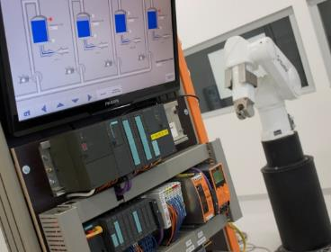
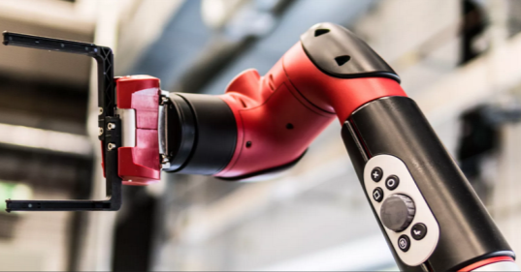

TECHNOLOGY CAMPUS
CHAM
Design and Simulation of a PID Controller for Precise DC Motor Speed Control
Prof: Sunil P. Survaiya
Cham,

Slide 3
Group Members
Praveen Kumar Cheerla - 12501601
Gamini Lokesh Chowdary - 12652811
Ameer khan Mohammed - 12652811
Ajith Kannan karipody -12652811

Slide 4
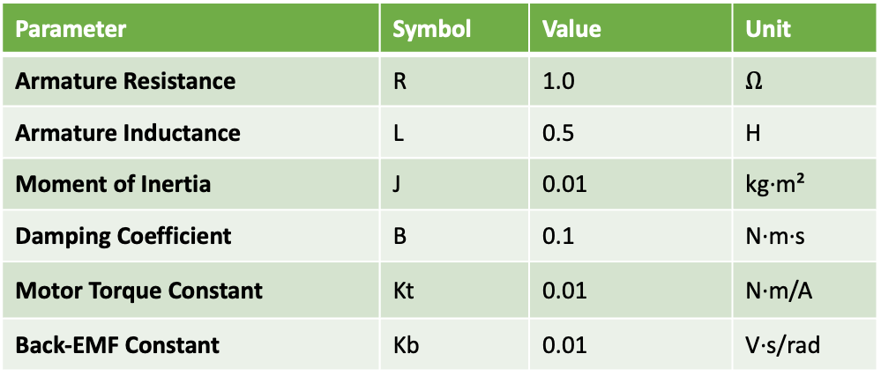
System Identification & Plant Parameters
Physical System Definition
Armature-Controlled DC Motor: The study focuses on a permanent magnet DC motor where the speed is regulated by varying the armature voltage ($V_a$).
System Objectives: The goal is to transform the motor from a "simple actuator" into a "precision machine" by compensating for load disturbances and supply noise.
Operation Domain: The system is analyzed as a multi-domain plant consisting of an Electrical Circuit (Armature) coupled to a Mechanical Load (Rotor).
Defined Plant Parameters
To perform a precise simulation, the following constant values must be established as the "Plant":
Parameter | Symbol | Value | Unit
Armature Resistance | R | 1.0 | $$Ω$$
Armature Inductance | L | 0.5 | H
Moment of Inertia | J | 0.01 | kg·m²
Damping Coefficient | B | 0.1 | N·m·s
Motor Torque Constant | Kt | 0.01 | N·m/A
Back-EMF Constant | Kb | 0.01 | V·s/rad
Notes:
When presenting this slide, emphasize that these parameters represent a specific hardware target. State that: "These values ($R, L, J, B$) define the physical limits of our mechatronic system. By identifying these early, we can use Root Locus or Frequency Response techniques to determine exactly how much gain ($K_p$) the system can handle before becoming unstable".

Slide 5
The "Electromechanical Bridge" (K_{t} and K_{b})
Torque Coupling (K_{t}): Explains how electrical energy becomes mechanical work. The motor torque (T_{m}) is directly proportional to the armature current (i_{a}) via the Torque Constant (K_{t}).
Voltage Feedback (K_{b}): Explains how mechanical motion regulates the electrical system. The rotation of the motor generates an internal "Back-EMF" voltage (e_{b}) proportional to the angular speed via the Back-EMF Constant (K_{b}).
Strategic Value: By defining K_{t} and K_{b} (both set to 0.01 in your project), you create a closed mathematical loop where the electrical and mechanical systems are inseparable.
Open-Loop Analysis: The Need for Control
Load Variations (T_{L}): In an open-loop system, if mechanical resistance (load) increases, the speed drops significantly because there is no mechanism to "ask" for more voltage to compensate.
Internal Friction (B): Viscous damping (set at 0.1 in your parameters) acts as a constant "drain" on performance, leading to what you've termed "precision deficits".
Open-Loop Instability: Without feedback, the motor cannot guarantee a consistent RPM under real-world conditions, making it unsuitable for precision tasks like robotics or CNC machining.
Notes:
"Beyond the raw numbers, the core of our Review 1 is the 'Electromechanical Bridge.' We recognize that a DC motor is not just two separate systems but a single coupled plant. By explicitly modeling $K_t$ and $K_b$, we capture the Back-EMF effect that naturally dampens the system. Our Open-Loop Analysis highlights that internal friction and external load variations make precision impossible without feedback. Therefore, we have opted for Deterministic Modeling—deriving the full second-order transfer function from first principles. This allows us to predict the system's poles and zeros with mathematical certainty, ensuring that our PID strategy is built on a verified physical foundation rather than an opaque software library."

Slide 6
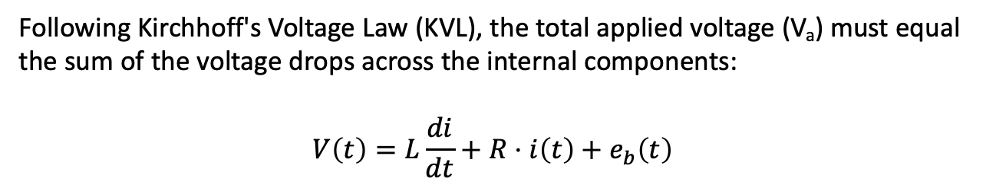
The Circuit Physics:
Kirchhoff’s Voltage Law
The armature of a DC motor is modeled as a series circuit containing a resistor (R_{a}), an inductor (L_{a}), and a voltage source representing the Back-EMF (e_{b}).
Following Kirchhoff's Voltage Law (KVL), the total applied voltage (V_{a}) must equal the sum of the voltage drops across the internal components:
$$V\left(t\right)=L\frac{di}{dt}+R⋅i\left(t\right)+e_{b}\left(t\right)$$
Armature Resistance (R_{a}): Represents the copper losses and heat dissipation in the motor windings.
Armature Inductance (L_{a}): Accounts for the magnetic field storage and the electrical time constant of the motor.

Slide 7
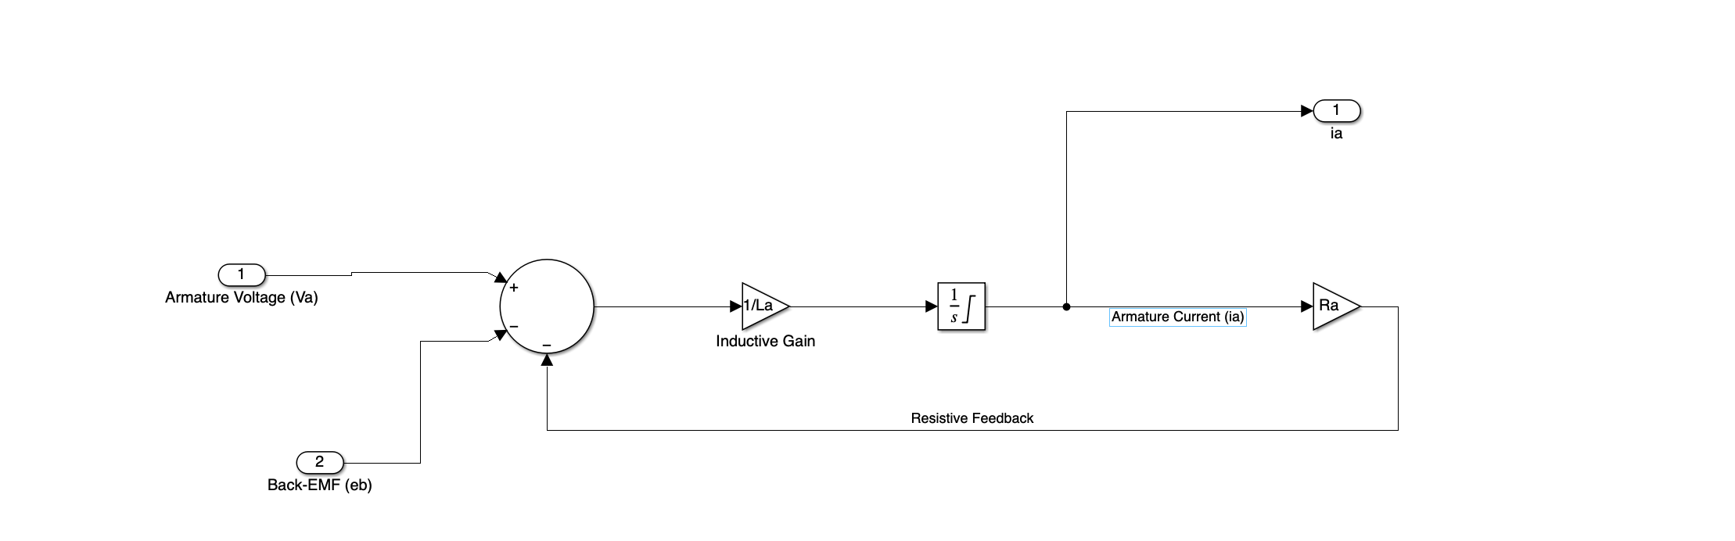
Simulink Model of Kirchhoff’s Voltage Law

Slide 8
The Back-EMF Phenomenon (e_{b})
The Generator Effect: As the armature rotates through the magnetic field, it generates a counter-voltage known as Back-EMF.
Mathematical Coupling: This voltage is directly proportional to the angular velocity of the motor shaft:
$$e_{b}\left(t\right)=K_{b}ω\left(t\right)$$
The Back-EMF Constant (K_{b}): This constant defines the electrical "damping" effect and is a fixed characteristic of the motor hardware.
Notes:
In this slide, we establish the electrical foundation of the plant. Using Kirchhoff's Voltage Law, we define the armature circuit as a second-order electrical system. It is vital to note that the applied voltage is not solely used for driving current; a significant portion is countered by the Back-EMF ($e_b$), which we have modeled as a linear function of the angular velocity, $\omega$. This represents our first coupling point between the electrical input and mechanical output. By identifying the inductance ($L_a$) and resistance ($R_a$), we can predict the electrical time constant, which is the first bottleneck in our system's overall response speed."

Slide 9

Mechanical Domain & The Electromechanical Bridge
The Mechanical Plant (Newton’s Second Law)
The Governing Equation: The motor torque (T_{m}) must overcome the rotor's rotational inertia and viscous damping:
$$J\frac{dω}{dt}+b⋅ω\left(t\right)=T_{m}\left(t\right)−T_{L}\left(t\right)$$
Moment of Inertia (J): Fixed at 0.01 kg . m² in our model, representing the physical resistance to angular acceleration.
Damping Coefficient (b): Fixed at 0.1 N . m. s, representing the internal friction losses.

Slide 10
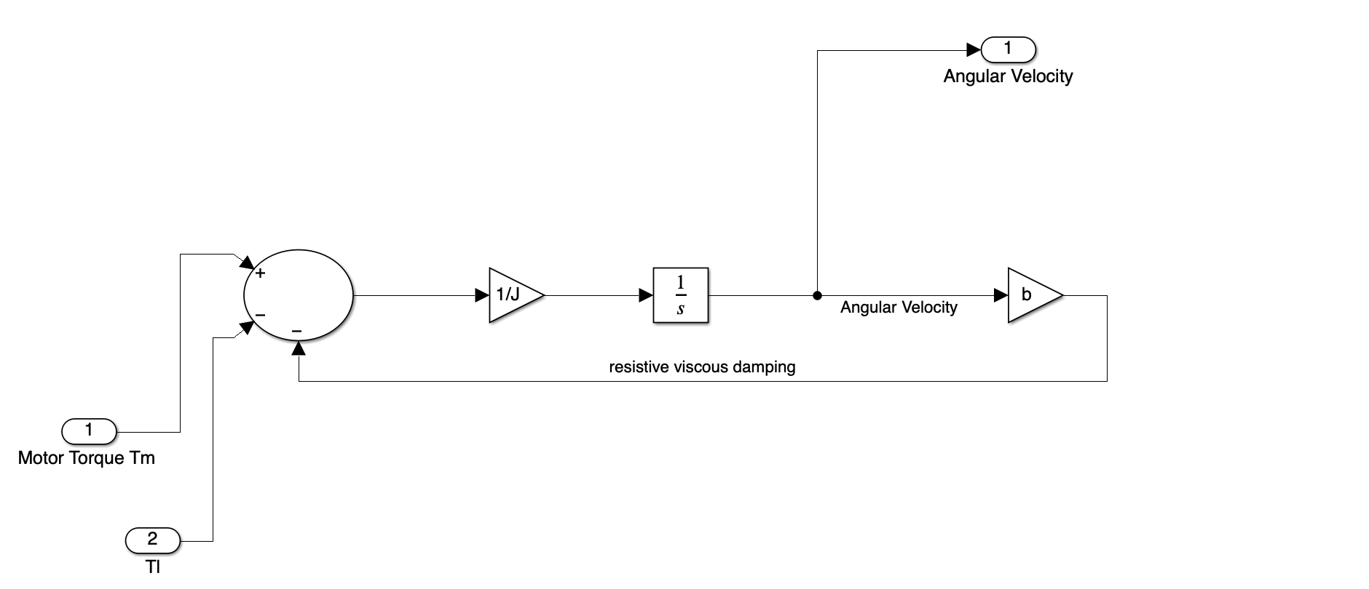
Simulink Model of Newton’s Second Law for Rotational Systems

Slide 11
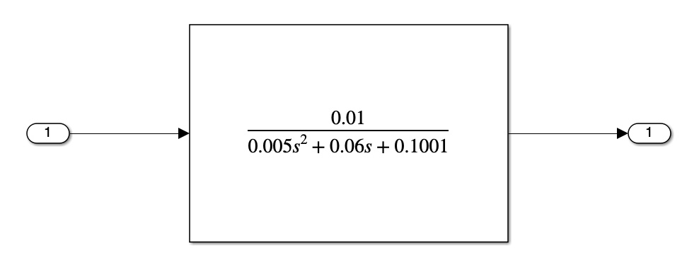

The System Transfer Function
By applying the Laplace Transform to our coupled equations (assuming zero initial conditions) and substituting the torque constant (K_{t}) and back-EMF constant (K_{b}), we arrive at the Final Transfer Function:
$$\frac{Ω\left(s\right)}{V\left(s\right)}=\frac{K_{t}}{\left(Ls+R\right)\left(Js+B\right)+K_{t}K_{b}}$$
Simulink Model of Transfer Function
Notes:
Mathematical Significance: This second-order equation is the "Deterministic Model" of our plant. It allows us to analyze the system's poles to determine stability and transient behavior before applying any control.
While the electrical domain defines our energy input, this slide captures the mechanical output—the actual rotation we intend to control. By coupling the electrical equation from the previous slide with Newton's Second Law, we derive the System Transfer Function. Notice the denominator: the term $K_tK_b$ represents the 'Electromechanical Bridge'. This term effectively increases the damping of the system, which is a critical insight for our tuning strategy. We are no longer looking at a motor; we are looking at a second-order mathematical plant that we can now manipulate using PID control laws."
"To conclude our Review 1 on System Modeling, we present the internal architecture of our deterministic plant. We have bypassed high-level libraries to build this model from the ground up in Simulink, explicitly showing the Back-EMF feedback loop that defines the motor's natural behavior. As our analysis shows, this open-loop system is highly susceptible to load disturbances and voltage noise. It possesses a significant steady-state error due to internal damping and a slow rise time dictated by the electromechanical time constants. This analysis confirms that while our plant model is mathematically sound and 'OK' for simulation, it requires an active closed-loop control strategy to achieve the precision required for Master's level robotics."

Slide 12
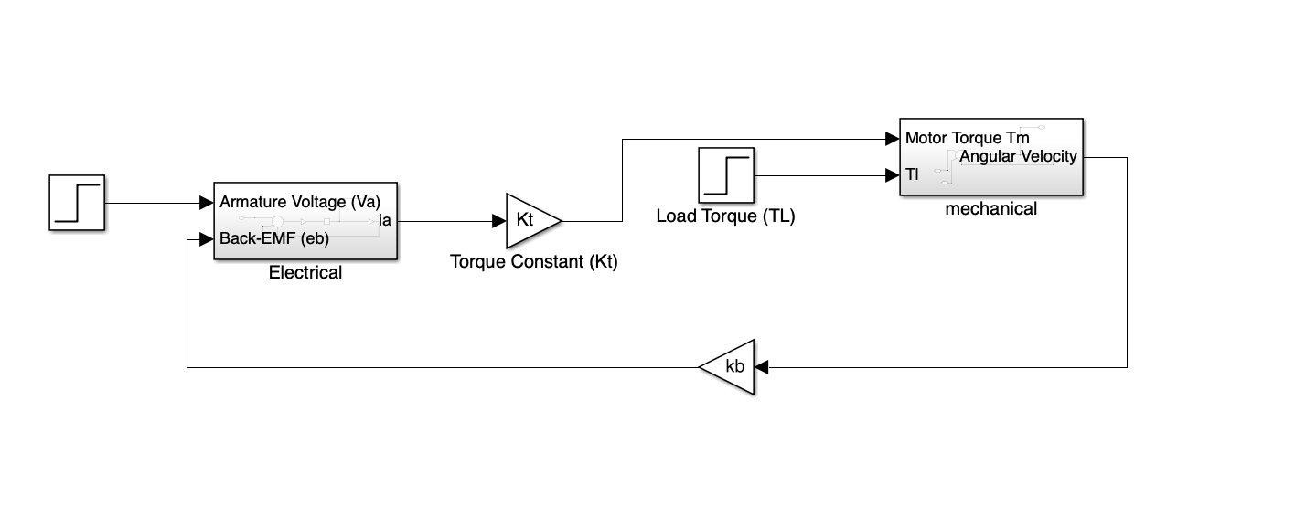
Detailed Simulink Architecture of DC motor

Slide 13
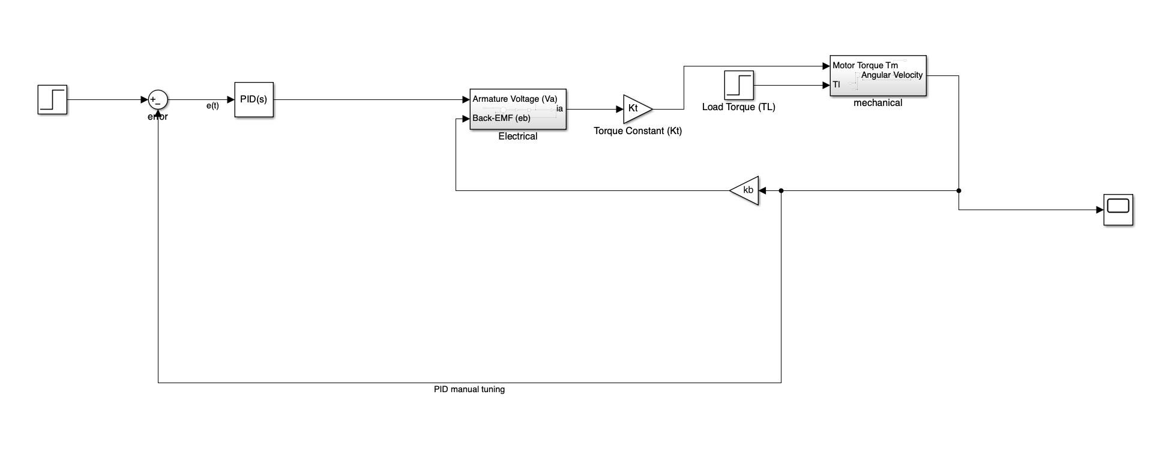
Closed-Loop PID Analysis & Architecture

Slide 14
Reference
https://www.researchgate.net/figure/Schematic-diagram-of-an-armature-controlled-DC-motor_fig1_365605456
https://www.researchgate.net/figure/a-Schematic-diagram-of-DC-motor-and-accessories-13-b-Simplified-schematic-diagram_fig6_311102892
https://scispace.com/pdf/dc-motor-speed-control-using-pid-controller-1fjix712dv.pdf
International Journal of Applied Engineering Research ISSN 0973-4562 Volume 14, Number 1 (2019) pp. 202-206 © Research India Publications. http://www.ripublication.com
Ang, K.H. and Chong, G.C.Y. and Li, Y. (2005) PID control system analysis, design, and technology. IEEE Transactions on Control Systems Technology 13(4):pp. 559-576.
The Application of PID Control in DC Motor Control Systems Jifan Chen College of Information Science and Technology, Donghua University, Shanghai,201600, China

Slide 15
Project:
Group members:
Date: 05-05-2026
Discussion Required:
Work completed /Status:
Topic selected: PID Controller Simulation for DC Motor (MATLAB/Simulink)
Problem statement defined
DC Motor mathematical model studied (electrical + mechanical equations)
PID theory reviewed (P, I, D terms and control law)
Simulink model structure planned
Tuning methods identified (Manual, Ziegler-Nichols, Auto-tune)
Concept presentation slides prepared
Build the DC Motor transfer function in Simulink
Implement the PID Controller block in closed-loop
Project Requirements:
MATLAB R2023a or later (with Simulink)
Control System Toolbox
Standard PC/Laptop ( simulation only)
Next Steps:
🔲 Apply all 3 tuning methods and run simulations
🔲 Record step response, settling time, overshoot, steady-state error
🔲 Compare results across tuning methods

